Slide 1
Eric Ravy
General Counsel

Slide 2
FROM THE UBERISATION TO AI : IS THERE ANY ROOM LEFT FOR LAWYERS?

Slide 3
75 websites
Present in 60 countries
4,580 billions of euro’s
100 million
travels
1200 Employees
40 000 Train tickets sold /Day on mobile

Slide 4
DIGITAL TRANSFORMATION OF LEGAL DEPARTMENT WHY ?
International evolution of the company
Competitive and regulatory environment, always changing
Global Digitalisation
Wish to progress professionally
Adaptation to change
Increased value of the Legal Department
INVENTING the Legal Department of TOMORROW

Slide 5
Our transformation
CONTRACTUAL POLICY
Dematerialised Contract database
Workflow validation
Electronic signature
NEW WORK METHODES
Collaborative Mode
Agile approach
BUSINESS PARTNER
Legal Department Organisation Company Organisation
Business Legal Planning
HOW?
MARKETING PLAN
Satisfaction survey
Trophées du droit
Prix de l’innovation
MISSION STATEMENT
KPIS
KNOWLEDGE MANAGEMENT
OUI Link
DIGITALISATION
New Reporting Tool
Project Management Tool
LEGAL ON LINE (BOT)
LEGALTECHS

Slide 6
AI + Bot + = Legal On Line

Slide 7
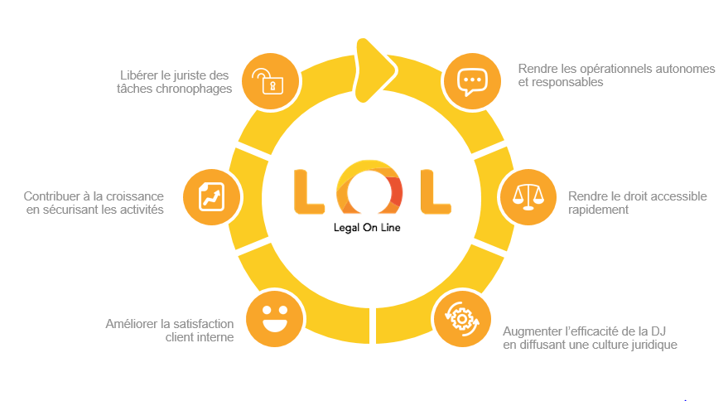
IA + Bot + = Legal On Line
Legal Department freed from time-consuming tasks
Autonomy & Responsability for operationnal staff
Contribution to growth
Quick access to Law
Full in-house satisfaction
Legal Department Efficiency
& Dissemination of the Legal Culture

Slide 8
Benefits for Oui.sncf
Enthusiasm
Focus on complex tasks
Supervised Autonomy
Visibility
Motivation
Project Management
Greater speed
& efficiency
EFFICIENCY
Augmented Lawyer
Agile FLEXIBILITY
CREATIVITY
Team work
Added Value

Slide 9
Thanks !

